Slide 1
Namibia
Namibia’s Communal Conservancy Tourism Sector
Joram Ndlovu

Slide 2
Learning Outcomes
After studying the case study, learners should be able to:
evaluate the role of tourism as both a conservation and development tool in Namibia, particularly in relation to wildlife conservation and employment creation in communities where few alternative job opportunities exist;
assess the extent to which strong incentives can redirect community efforts to manage their natural resources in a sustainable manner to enhance their livelihoods;
discuss ways in which communities can capitalise on rapidly growing global tourism demands to boost tourism revenues and diversify their rural livelihoods away from primary traditional subsistence farming; and
provide insights with regard to benefit sharing and make feasible recommendations on tourism governance in the conservancy tourism sector

Slide 3
Background
Namibia is depended on mineral, agriculture, fisheries and tourism for its Gross Domestic Product (GDP)
Namibia was the first African country to incorporate CBNRM in its constitution
The tourism sector has been regarded a priority area for BBEE and TIPEEG intervention programmes
CBNRM seeks to curb cases of poaching, increase conservation of natural resources and sustainable development

Slide 4
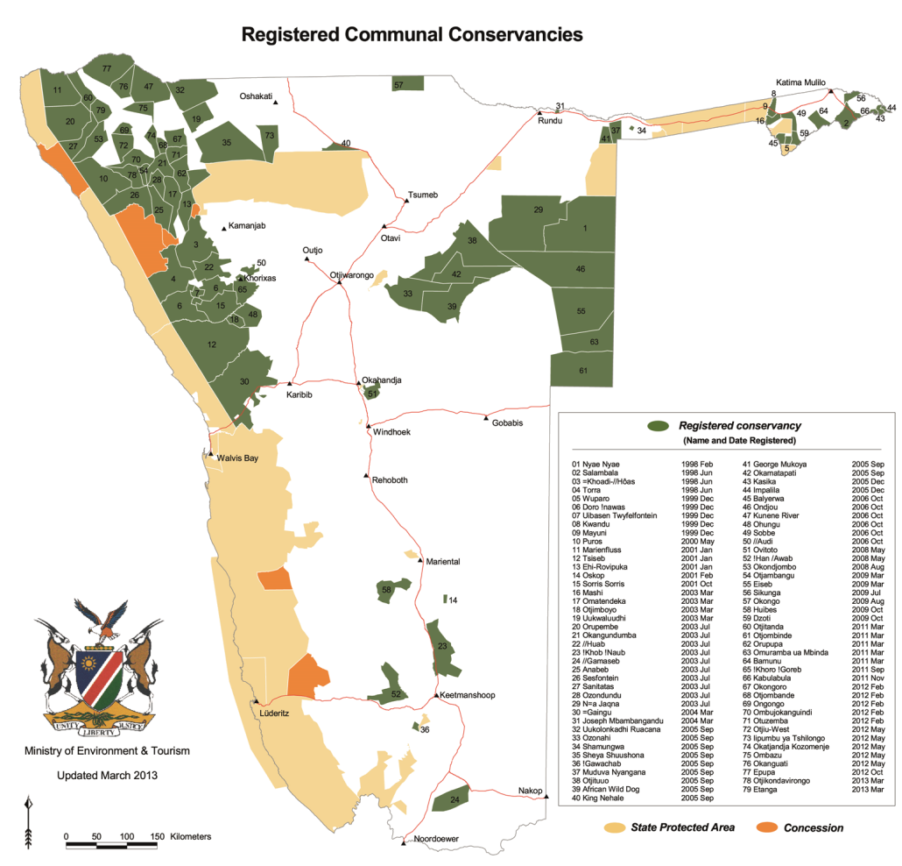
Background

Slide 5
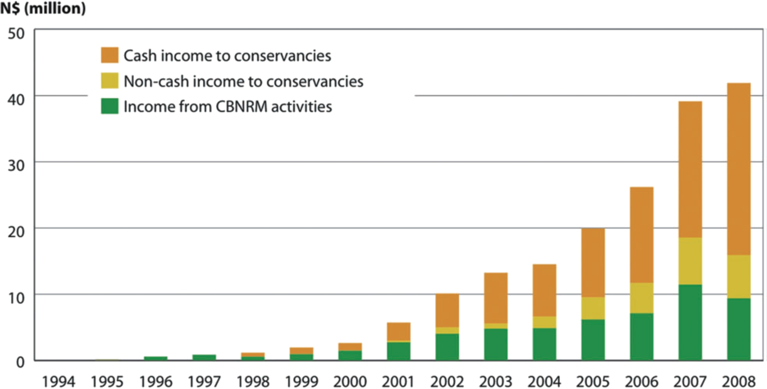
Background
Income to conservancies and from CBNRM activities

Slide 6
Achievements
Devolvement of rights over natural resources to communities
Significant growth in the number of registered conservancies from 4 in 1998 to 59 in 2010
By 2010, 16,1% of the land is under conservation with an income of N$ 45.8 million
Increased direct and indirect benefits for the local communities
Community participation in decision making regarding their natural assets
Restoration and translocation of wildlife to local communities to expand range and population of species
Infrastructural development and improved livelihoods

Slide 7
Theoretical Context & Analysis
Devolve proprietorship over land to a group of individuals.
Define membership, area to be owned and managed, rules, and enforce those rules
For residents to participate in tourism there should be benefits
Ensure that the perceived benefits exceed perceived costs
Explain how individual and societal norms, values, believes and residents’ attitudes are managed for a common goal
Community’s attitudes towards tourists through stages of euphoria to antagonism
Destination life cycle goes through stages of exploration to either decline or rejuvenation.
Sustainable tourism development should achieve economic wellbeing, optimum guest satisfaction, healthy culture, environmental protection and subjective wellbeing of locals.

Slide 8
Future outlook
Conservancies can improve the livelihoods of communities in a sustainable way
The continued ownership of the land by the state can jeopardise the future success of conservancies
Exclusive rights does not mean ownership
Since communities do not own the land, they cannot use it as collateral or surety or financial investment in an enterprise
Need to remove barriers through policy interventions and attract investment
Complete empowerment of communities to operate joint venture businesses once the contract with an investor expires
Collaboration of stakeholders

Slide 9
Conclusions
CBNRM is the centre piece of conservancies
Namibia has led the way in conservation in Southern Africa? Worldwide?
The government, private sector and NGOs have participated meaningfully in championing the conservancy sector
The conservancy sector has provided the linkages between conservation and development
The promulgation of a tourism policy has opened the doors for local community empowerment
The case study demonstrates the extent to which the Government can influence the development through tourism
The case study has also brought new insights into the complexity of tourism as a rural development strategy and how wildlife can be restored through conservation

Slide 10
Study Questions
Based on the case study, discuss the concept of a communal conservancy in Namibia. Analyse the challenges faced by the Government in addressing socio-economic problems confronted by the rural poor in Namibia. Briefly explain the policies that have helped in the formation a community level conservancy in Namibia
Studies have shown that there is a need for partnerships; not exclusively between the private sector and communities, but widely across the industry due to the diversity of stakeholders. To what extent do these partnerships have the potential to result in sustainable tourism development and what measures should be taken to ensure that these partnerships yield tangible results?
The future of the community conservancy sector is bright in Namibia. Suggest five major points that should be addressed to ensure that this dream is realised and that the destination capitalises on its competitive advantage.
Discuss the challenges faced by CBT and recommend mitigation measures that would ensure the achievement of sustainable tourism development without compromising social equity, environmental sustainability, and economic efficiency.
Discuss the major achievements of Community Based Natural Resources Management in Namibia.

